Slide 1
Food Waste Problem in Restaurant
Our project to solve this problem

Slide 2


The Problem
Restaurant
According to the Cornell University Food and Brand Lab, on average, diners leave 17 percent of their meals uneaten and 55 percent of edible leftovers are left at the restaurant.
Foodprint.org

Slide 3
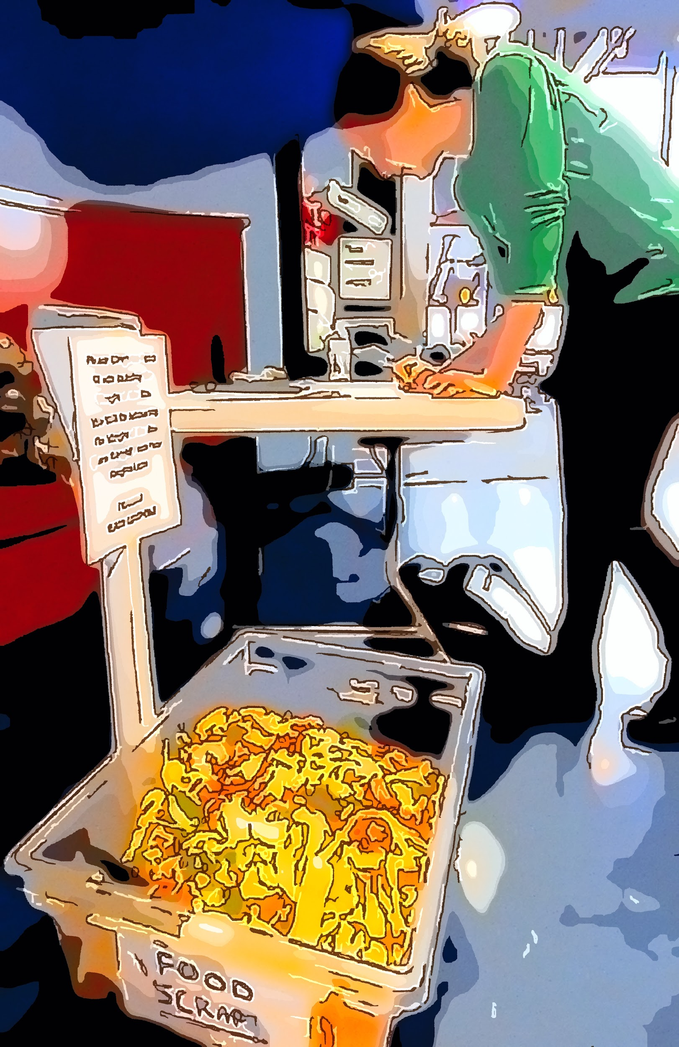
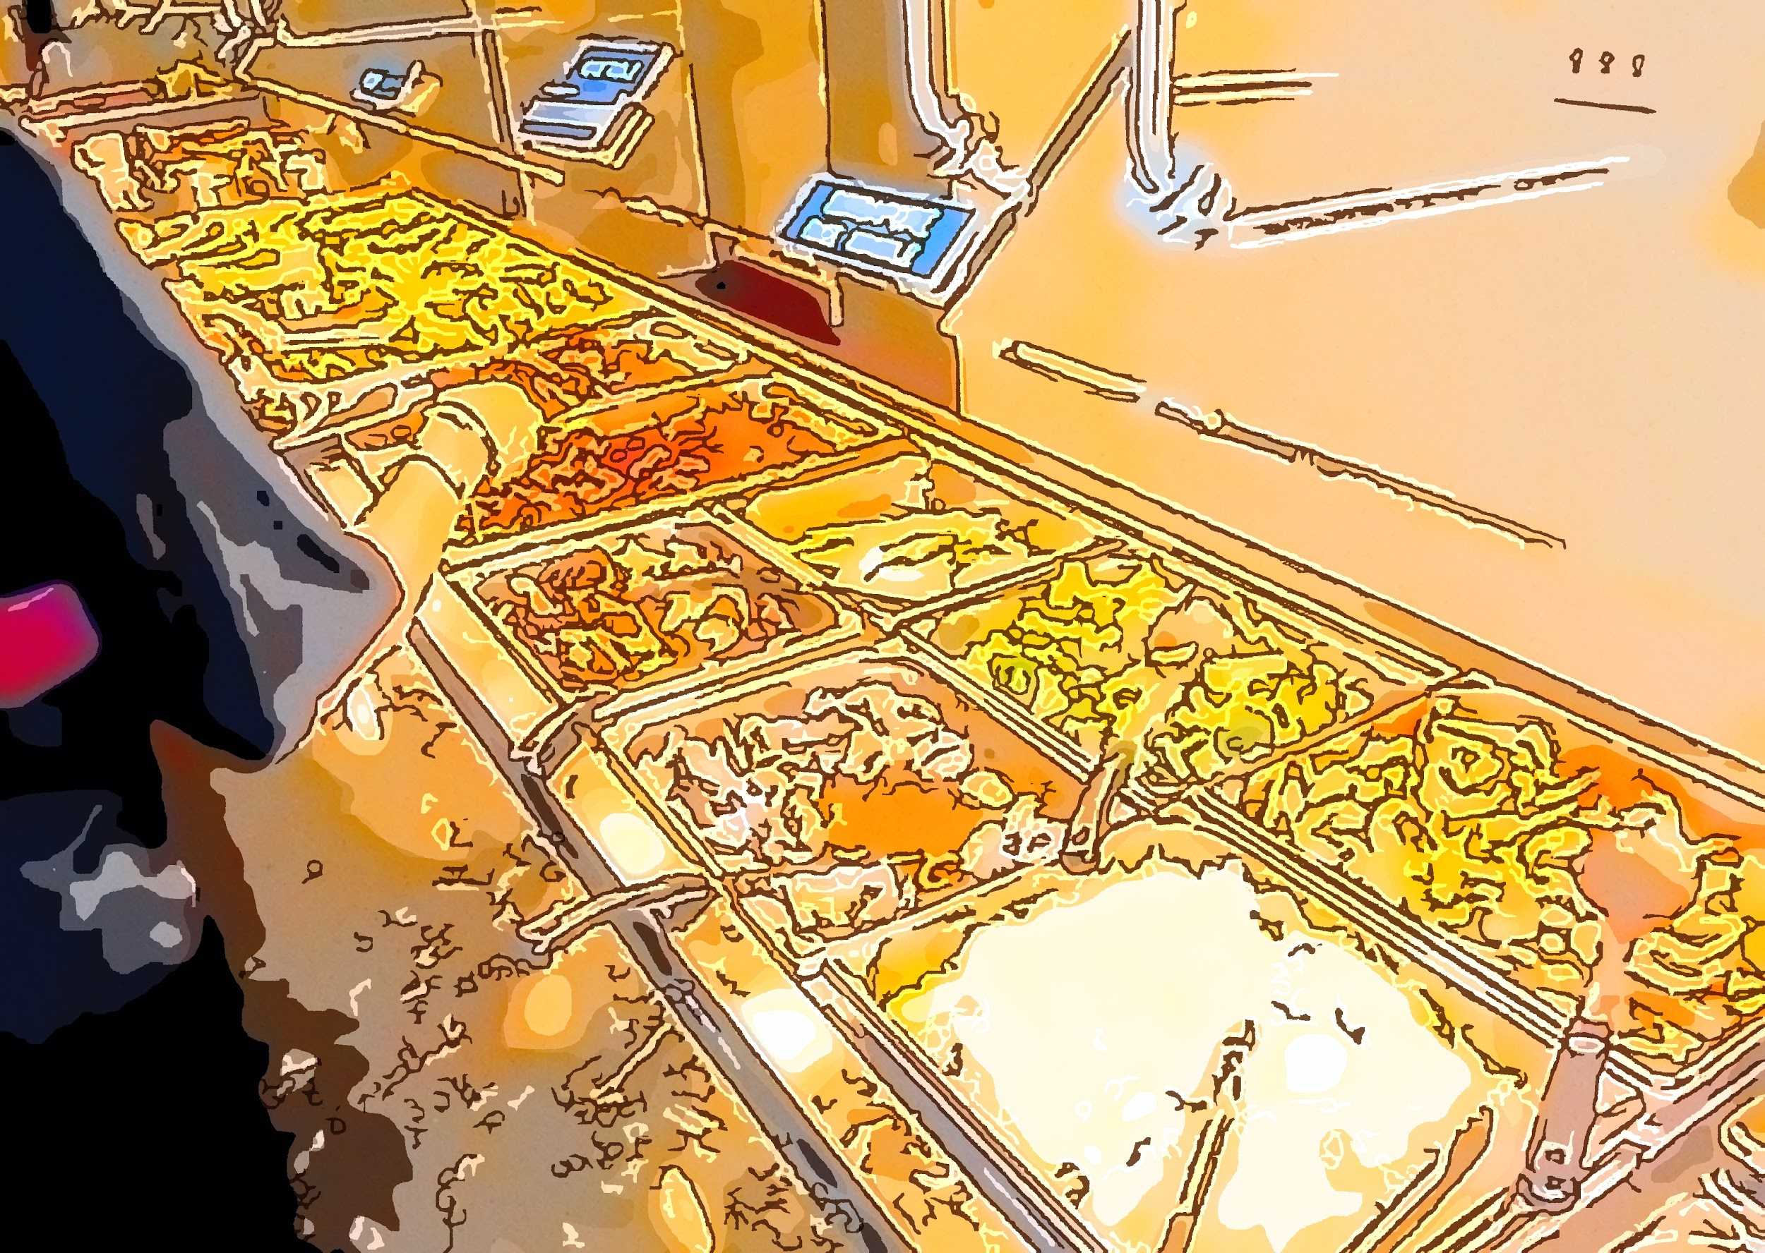
Challenging
It’s
a Big
Problem
.
. If we can solve this problem we will be able to provide a lot of wasted food.

Slide 4
The Solution
Encourage people not to leave their food

Slide 5
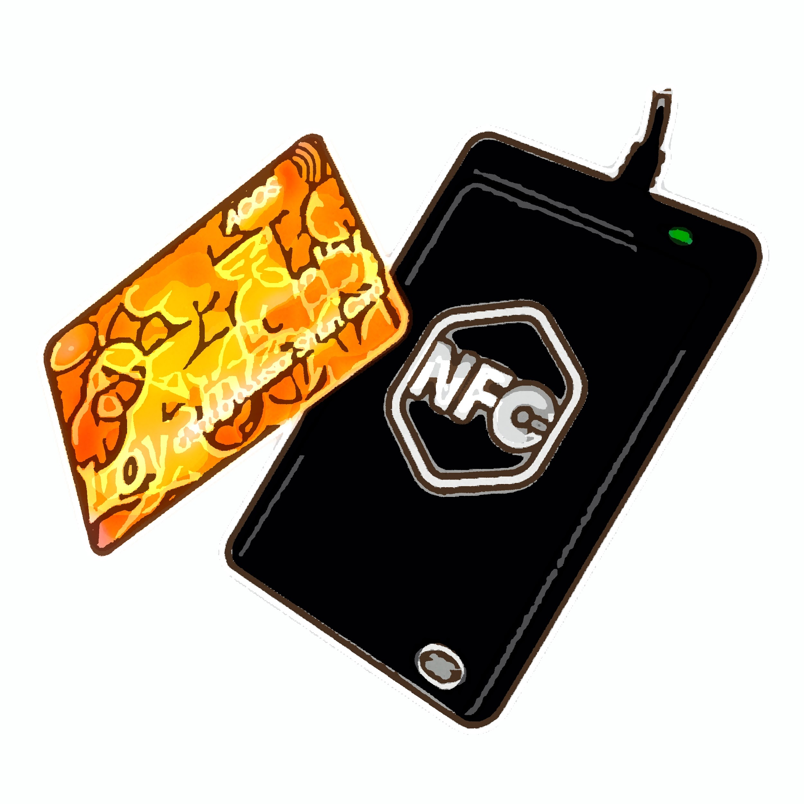
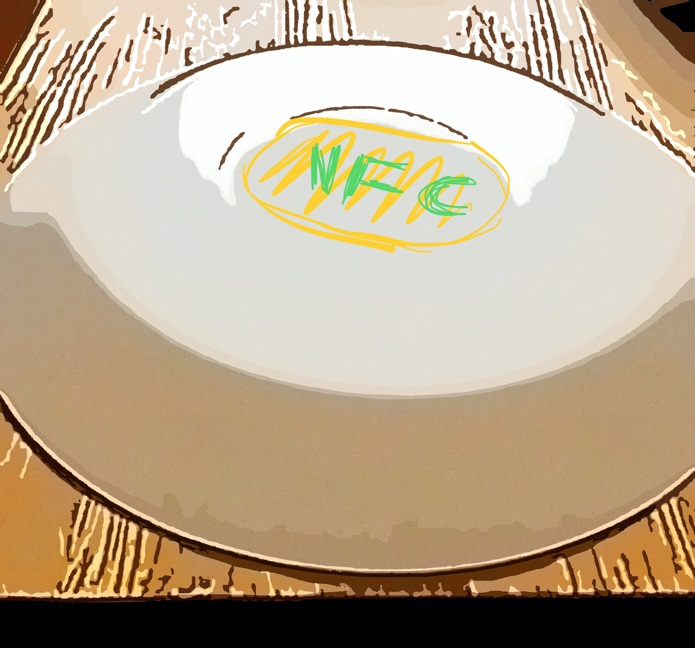
The restaurant ‘ll provid a NFC credit card , also all plates ‘ll be equipped with waterproof NFC, it ‘ll be in the backside of the plates.

Slide 6
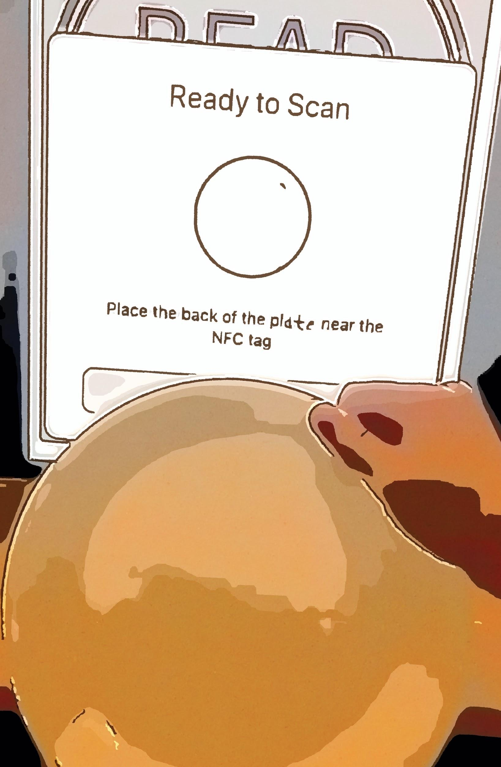
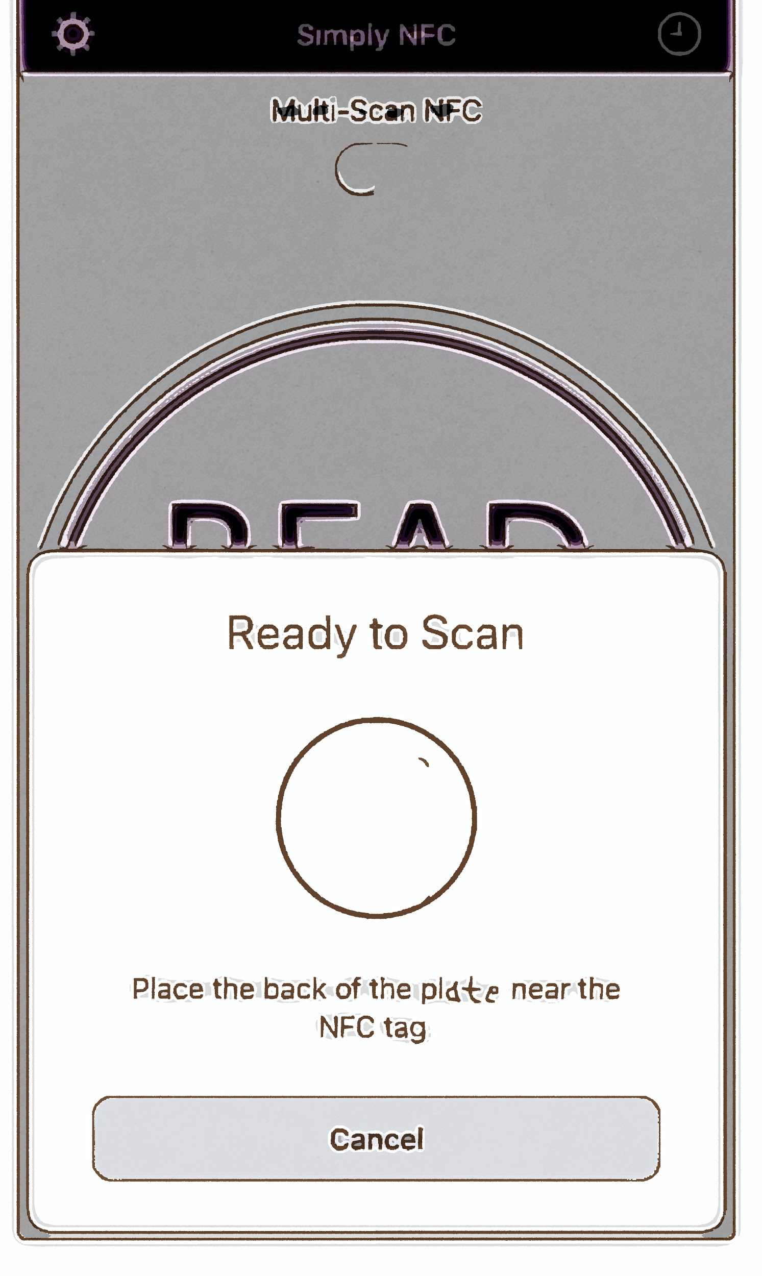
When the customer finishes eating
Open the check in using the customer’s credit card
Done, it’ll be save a one point in the customer’s credit card.
Finish eating
Empty plate?
Check in
Scanning
Get One Point
Prepare all customers’ plates as empties
The customer is scanning all plates in a vertical direction

Slide 7
The End
Thank you for your listening

